Slide 1

Data Warehousing and Data Mining
Audio_Lec_04
Notes:
AoA Students, Welcome to another lecture of our audio based lectures series. In the last lecture, we started discussion on indicators of low quality data. In today’s lecture, we will discuss about possible causes of low quality data and source of data pollution.

Slide 2
Possible causes of low quality data
Dummy values: For example, to pass a check on postal code, entering dummy or not precise information such as 4444 (dummy) or 54000 for all regions of Lahore
Absence of data values: For example not a complete address
Unofficial use of field: For example writing comments in the contact field of the customer
Notes:
In this slide I will elaborate some possible causes of low quality. So here is the detail:
Dummy values, some times people enter dummy values in a field. For example, to pass a check on postal code, we enter dummy or not precise information such as 4444 as dummy value or we may enter 54000 for all regions of Lahore.
Absence of data values: This means that the data values has not been entered. For example not a complete address where either city, country or other part of the address is missing.
Unofficial use of field: This means to enter an information in a field for which that field is not meant for. For example, writing comments in the contact field of the customer.
Please move to the next slide

Slide 3
Possible causes of low quality data
Cryptic Information: At one time operation system was using ‘R’ for “remove” then later for “reduced” and some other time point for “recovery”
Contradicting values: compatible fields must not contradict, e.g., two fileds ZIP code and City can have values 54000 and Lahore but not some other city name for ZIP code 54000
Notes:
4. Cryptic Information. It means some reserve codes that were intended for something in past but over the time its meaning has changed. For example, at one time an operational system was using ‘R’ for ‘remove’ then later for ‘reduced’ and some other time point for ‘recovery’. It can be seen that the meaning of ‘R’ has changed over the period of time. We need to be careful while dealing with such situation and resolve this issue before loading data in data warehouse.
5. Contradicting values: It means that compatible fields must not contradict. For example. Two fields, i.e., zip code and city information can have values 54000 and Lahore respectively. However, if there is some entry of another city name with zip code 54000 that means that quality of data is low.

Slide 4
Possible causes of low quality data
Violation of business rule: Issued loan is negative
Reused primary keys: For example, a business has 2 digit primary key. It can have maximum 100 customers. When a 101th customer comes the business might archive the old customers and assign the new customer a primary key from the start. It might not be a problem for the operational system but you need to resolve such issues because DW keeps historical data.
Notes:
6. Violation of business rule. This means that while data storing in operational systems the business rules have not been enforced. For example issued loan cannot be negative.
7. Reused primary keys. This is also cause of low quality data. For example, a business has 2 digit primary key. It can have maximum 100 customer with keys from 00 to 99. Imagine when a 101th customer comes the business might archive the old customers and assign the new customer a primary key from the start. It might not be a problem for the operational system but we need to resolve such issues because DW keeps historical data.

Slide 5
Possible causes of low quality data
Non-unique identifiers: For example different product codes in different departments
Inconsistent values: one system is using male/female to represent gender while other system is using 1/0
Incorrect values: Product Code: 466, Product Name: “Crystal vas”, Height:”500 inch”. It means that product and height values are not compatible. Either product name or height is wrong or maybe the product code as well
Notes:
8. Non-unique identifiers. This means for example that different codes are being used in different departments for different reasons. We need to resolve this issue before transferring data to DW.
9. Inconsistent values: This has been discussed earlier as well. Since in DW data comes from different sources; therefore, it is quite possible that different systems might be using different values to represent an attribute. For example, one system is using male/female to represent gender while other system might be using 1/0 to represent gender.
10. Incorrect values: Imagine there is a product code:466, product name: ‘crystal vas’, and height: 500 inch. These values seems not compatible as crystal vas of 500 inch. How is it possible? There might be a problem. It might be that either product name or height is wrong or maybe the product code as well. In this case we need to re-verify the given information.

Slide 6
Possible causes of low quality data
Erroneous integration: A person might be a buyer and seller to your business. Your customer table might be storing such person with ID 222 while in seller table it might be 500. In data warehouse you might need to integrate this information. The persons with IDs 222 in both tables might not be same
Notes:
11. Erroneous integration: Sometimes it happens that a person might be a buyer and seller to your business. Your customers table might be storing such person with ID 222 while in seller table it might stored with ID 500. It DW, you might need to integrate this information to do some analysis. In this case you need to be careful as the persons with IDs 222 in both tables might not be the same person.
Having discussed some possible causes of low quality data. Let us now discuss some important sources of data pollution. For details please move to the next slide.

Slide 7
Sources of data pollution
System migration or conversions: For example, from manual system→ Flat files → Hierarchal databases → relational databases….
Integration of heterogeneous systems: More heterogeneity means more problems
Poor database design: For example lack of business rules, lack of entity and referential integrity
Notes:
In your DW project you might encounter different sources for data pollution. Here in this slide we discuss some of possible sources of data pollution.
System migration or conversions: An operational system or systems might have evolved over the period of time. It might be possible that the underlying source system might be manual then it might had been converted on flat files. After that it might have shifted on hierarchal databases and later to relational databases and so on. If the operational system has undergone more migrations or conversions then you might have to face more inconsistencies or conversion problems before transferring data to your DW.
Integration of heterogeneous systems: This means more heterogeneity in operation systems that you are integrating then you have to face more problems.
Poor database design: As we already discussed, a poor database design can be a source of low quality data. For example, lack of business rules, lack of entity and referential integrity may be cause of low quality data for your DW.

Slide 8
Sources of data pollution
Incomplete data entry: For example, no city information
Wrong information during entry: For example United Kingdom → Unted Kingdom
Notes:
4. Incomplete data entry: for example, no city information in address
5. Wrong information during entry: For example, spelling mistakes or errors while entering data in operational system
I think we have discussed enough about indicators of low quality data, there possible causes and their possible sources. This discussion will help you to be better equipped while ensuing data quality in your DW project and to take appropriate actions to perform data cleansing.
Now, please move to the next slide to see the overall framework of data cleansing.

Slide 9
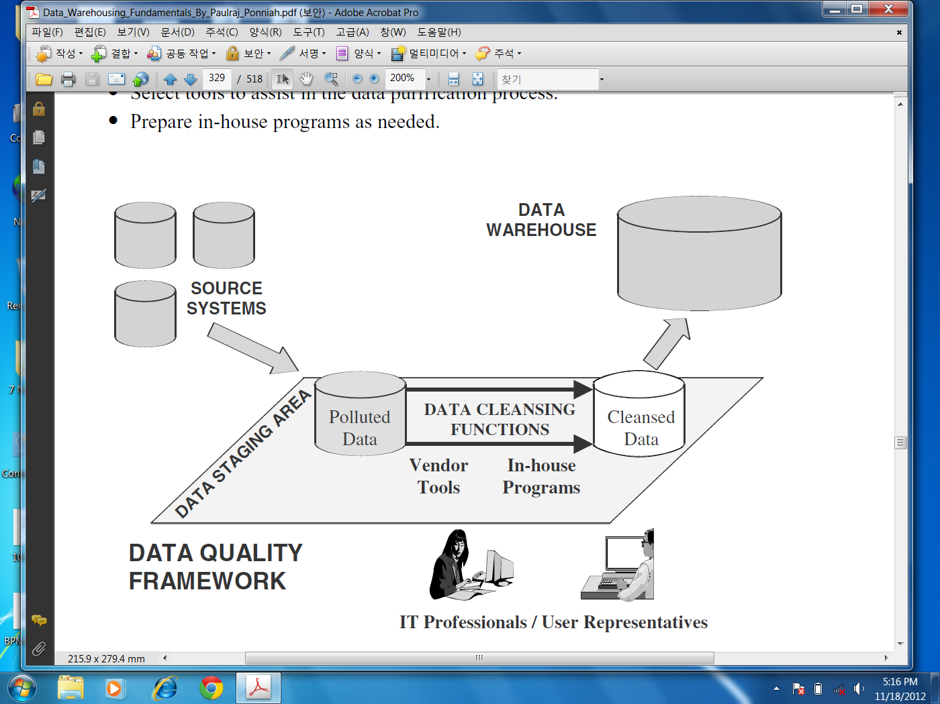
Data Cleansing
Notes:
In this slide you can see an overall data cleansing framework. Basically what it shows is that, before transferring data in DW in data staging area you need to use either vendor tool or write you own in-house programs/scripts to perform data cleaning of polluted data obtained from operational systems. After data cleansing the cleansed data is then transferred to DW for analysis or decision making.
Let us now move to the next slide to see some Vendors tools to perform data cleansing.

Slide 10
Examples of data cleansing tools
Data Ladder, http://www.dataladder.com/products.html
Human Inference,
http://www.humaninference.com/master-data-management/data-quality/data-cleansing
Google Refine,
http://code.google.com/p/google-refine/
Wrangler
http://vis.stanford.edu/wrangler/
Text Pipe Pro
http://www.datamystic.com/textpipe.html#.UKjm9eQ3vyo
Notes:
Here in this slide, some examples of data cleaning tools have been listed. You can explore them by yourself. Remember if you could not find a suitable tool to perform data cleaning then you have to write your own programs or scripts to cleanse data as per your requirements.
I hope you liked our today’s lecture. IA we will meet in our next lecture. Till then Allah Hafiz and stay safe.

